Slide 1

Chapter 9
Models of Optimal Well-Being

Slide 2
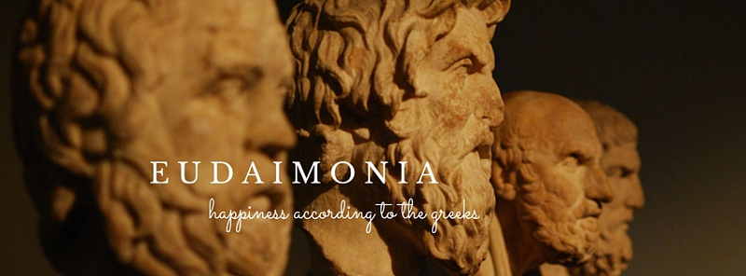
Models of Optimal Well-Being
Focus on this chapter: Eudaimonia perspective of well-being
Personal growth
Optimal self-development
Search for meaning
This perspective assumes primary goals in life involve search for personal growth and meaning; happiness and positive emotion are regarded as by-products of that search

Slide 3
Wisdom
Wisdom
Greek philosophy
Wisdom is the ultimate goal of life
Jewish tradition
Wisdom is a venerated quality associated with highly ethical life
Research psychologists avoided the topic of wisdom

Slide 4
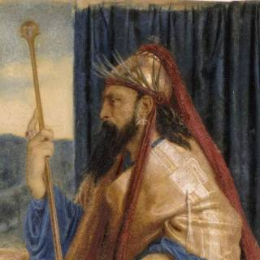
Wisdom
Preliminary wisdom about Wisdom
Unique positive result of long developmental processes
Implies knowledge that is social, interpersonal, and psychological
Difficult for the average person to attain
Kramer: elements of wisdom: openness to experience and capacity to reflect on and grapple with difficult existential life issues
Notes:
Definitions by scholars:
Kramer (2000) stated that wisdom is “exceptional breadth and depth of knowledge about the conditions of life and human affairs.” Kramer (2000) also reviewed much of the existing research on wisdom. In her view, the two major elements of wisdom are greater openness to experience and a “capacity to reflect on and grapple with difficult existential life issues.”
According to Clayton (1982), “Wisdom is...the ability that enables the individual to grasp human nature, which operates on the principles of contradiction, paradox, and change. Human nature is being used here to refer to understanding of self and understanding of others.”
Labouvie-Vief (1990) proposed that wisdom involves the dialectical integration of two forms of knowledge: logos and mythos. Logos is knowledge gained through the use of analytical, propositional, and other formal structures of logic. Mythos is knowledge gained through speech, narrative, plot, or dialogue.
Pascual-Leone (1990) sounded similar themes in his perspective on wisdom. What he added is a theoretical statement on what he calls the “ultraself” or “transcendent self” as a hallmark of wisdom. This ultraself operates as a higher, more encompassing, center of information processing able to integrate cognitive and emotional processes, particularly love and care.

Slide 5
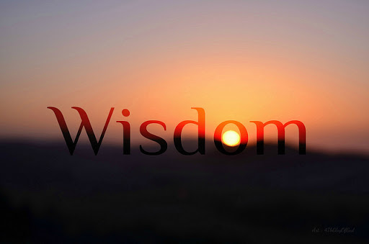
Wisdom
Preliminary wisdom about Wisdom
J. Webster measures wisdom with five components
Openness to experience
Emotional regulation
Healthy coping with critical life experience
Reminiscence and reflectiveness
Self-effacing sense of humor that recognizes life ironies
Notes:
Webster (2003) measures wisdom with five components: Openness to experience, emotional regulation, healthy coping with critical life experiences, reminiscence and reflectiveness, and a self-effacing sense of humor that recognizes life ironies.
Wink and Helson’s two forms of wisdom:
Practical wisdom.
Transcendental wisdom.
Kunzmann and Strange’s three basic ways of defining wisdom:
Mature personality development.
Post-formal reasoning.
Expanded form of pragmatic or practical intelligence.
Bangen, Meeks, and Jeste’s elements or traits usually associated with wisdom: knowledge of life, prosocial values, self-understanding, emotional homeostasis, tolerance, openness, self-understanding, and a sense of humor

Slide 6
Wisdom
Preliminary wisdom about Wisdom
Wink and Helson’s two forms of wisdom
Practical wisdom (good interpersonal skills, clarity of thinking, greater tolerance, generativity)
Transcendental wisdom (deals with limits of knowledge, rich complexity of the human experience, sense of transcending the personal and individual aspects of human experience)
Notes:
Webster (2003) measures wisdom with five components: Openness to experience, emotional regulation, healthy coping with critical life experiences, reminiscence and reflectiveness, and a self-effacing sense of humor that recognizes life ironies.
Wink and Helson’s two forms of wisdom:
Practical wisdom.
Transcendental wisdom.
Kunzmann and Strange’s three basic ways of defining wisdom:
Mature personality development.
Post-formal reasoning.
Expanded form of pragmatic or practical intelligence.
Bangen, Meeks, and Jeste’s elements or traits usually associated with wisdom: knowledge of life, prosocial values, self-understanding, emotional homeostasis, tolerance, openness, self-understanding, and a sense of humor

Slide 7
Wisdom
Preliminary wisdom about Wisdom
Kunzmann and Strange’s three basic ways of defining wisdom
Mature personality development
Post-formal reasoning
Expanded form of pragmatic or practical intelligence
Notes:
Webster (2003) measures wisdom with five components: Openness to experience, emotional regulation, healthy coping with critical life experiences, reminiscence and reflectiveness, and a self-effacing sense of humor that recognizes life ironies.
Wink and Helson’s two forms of wisdom:
Practical wisdom.
Transcendental wisdom.
Kunzmann and Strange’s three basic ways of defining wisdom:
Mature personality development.
Post-formal reasoning.
Expanded form of pragmatic or practical intelligence.
Bangen, Meeks, and Jeste’s elements or traits usually associated with wisdom: knowledge of life, prosocial values, self-understanding, emotional homeostasis, tolerance, openness, self-understanding, and a sense of humor

Slide 8

Wisdom
Preliminary wisdom about Wisdom
Bangen, Meeks, and Jeste’s elements or traits usually associated with wisdom
Knowledge of life
Prosocial values
Self-understanding
Emotional homeostasis
Tolerance
Openness
Self-understanding
Sense of humor
Notes:
Webster (2003) measures wisdom with five components: Openness to experience, emotional regulation, healthy coping with critical life experiences, reminiscence and reflectiveness, and a self-effacing sense of humor that recognizes life ironies.
Wink and Helson’s two forms of wisdom:
Practical wisdom.
Transcendental wisdom.
Kunzmann and Strange’s three basic ways of defining wisdom:
Mature personality development.
Post-formal reasoning.
Expanded form of pragmatic or practical intelligence.
Bangen, Meeks, and Jeste’s elements or traits usually associated with wisdom: knowledge of life, prosocial values, self-understanding, emotional homeostasis, tolerance, openness, self-understanding, and a sense of humor

Slide 9
Wisdom
Preliminary wisdom about Wisdom
Bassett Theory of Emergent Wisdom
Wisdom emerges out of a complex series of interactions among various wisdom-related capabilities and abilities
Notes:
Webster (2003) measures wisdom with five components: Openness to experience, emotional regulation, healthy coping with critical life experiences, reminiscence and reflectiveness, and a self-effacing sense of humor that recognizes life ironies.
Wink and Helson’s two forms of wisdom:
Practical wisdom.
Transcendental wisdom.
Kunzmann and Strange’s three basic ways of defining wisdom:
Mature personality development.
Post-formal reasoning.
Expanded form of pragmatic or practical intelligence.
Bangen, Meeks, and Jeste’s elements or traits usually associated with wisdom: knowledge of life, prosocial values, self-understanding, emotional homeostasis, tolerance, openness, self-understanding, and a sense of humor

Slide 10
Wisdom
Preliminary wisdom about Wisdom
Summary
Researchers agree it is not simply the presence of certain traits or variables or elements; it is the way they interact
Notes:
Webster (2003) measures wisdom with five components: Openness to experience, emotional regulation, healthy coping with critical life experiences, reminiscence and reflectiveness, and a self-effacing sense of humor that recognizes life ironies.
Wink and Helson’s two forms of wisdom:
Practical wisdom.
Transcendental wisdom.
Kunzmann and Strange’s three basic ways of defining wisdom:
Mature personality development.
Post-formal reasoning.
Expanded form of pragmatic or practical intelligence.
Bangen, Meeks, and Jeste’s elements or traits usually associated with wisdom: knowledge of life, prosocial values, self-understanding, emotional homeostasis, tolerance, openness, self-understanding, and a sense of humor

Slide 11
Wisdom
Preliminary wisdom about Wisdom
Wisdom is not the inevitable outcome of advanced age
Seen more often in at least middle-aged persons
Certain age-related changes may be a hindrance to wisdom unless one actively pursues its development (e.g., declining cognitive resources)
Relationship between age and wisdom may be specific to culture
Note: your textbook has one sentence on research on age and wisdom with participants from US and Japan…highly recommend you read the original source to understand their comment in the book
Wisdom is not intelligence as measured by IQ tests

Slide 12
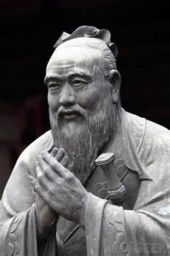
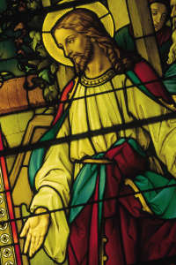
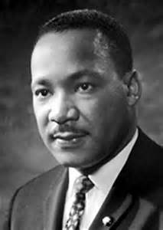
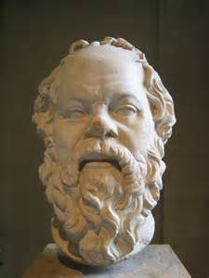
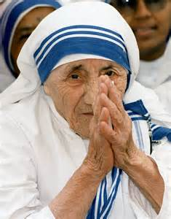
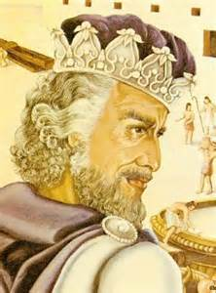
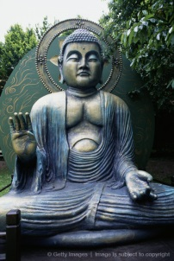
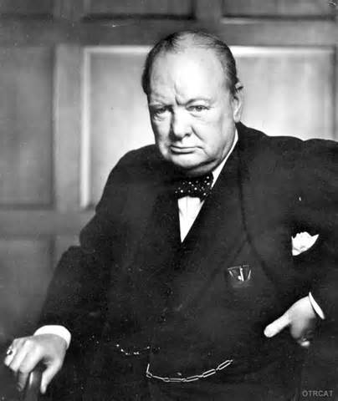
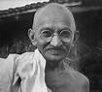
College Students View of Wise People
Top 15 People identified as wise:
Gandhi, Confucius, Jesus Christ, ML King Jr., Socrates, Mother Theresa, Solomon, Buddha, Pope, Oprah Winfrey, Winston Churchill, Dalai Lama, Ann Landers, Nelson Mandela, Queen Elizabeth

Slide 13
College Students View of Wise People
6 Attributes that characterize a wise person
Reasoning ability
Look at problem and solve using logic, apply knowledge to problems, integrate info in new ways, possess much knowledge
Sagacity (knowledge)
Keen understanding of human nature, thoughtfulness, fairness, good listening abilities, knowledge of self, and placing value on advice and knowledge of others
Learning from ideas and the environment
Places value on ideas, is perceptive, and learns from others’ mistakes

Slide 14
College Students View of Wise People
6 Attributes that characterize a wise person
Judgment
Has good, sensible judgment at all times, takes a long-term view, and thinks before acting and speaking
Expeditious use of information
Learns and retains information from experience, willingness to change one’s mind based on new experience
Perspicacity (perceptive)
Demonstrates perceptiveness, intuition, ability to see through things, read between the lines; and discern the truth and the right thing to do

Slide 15
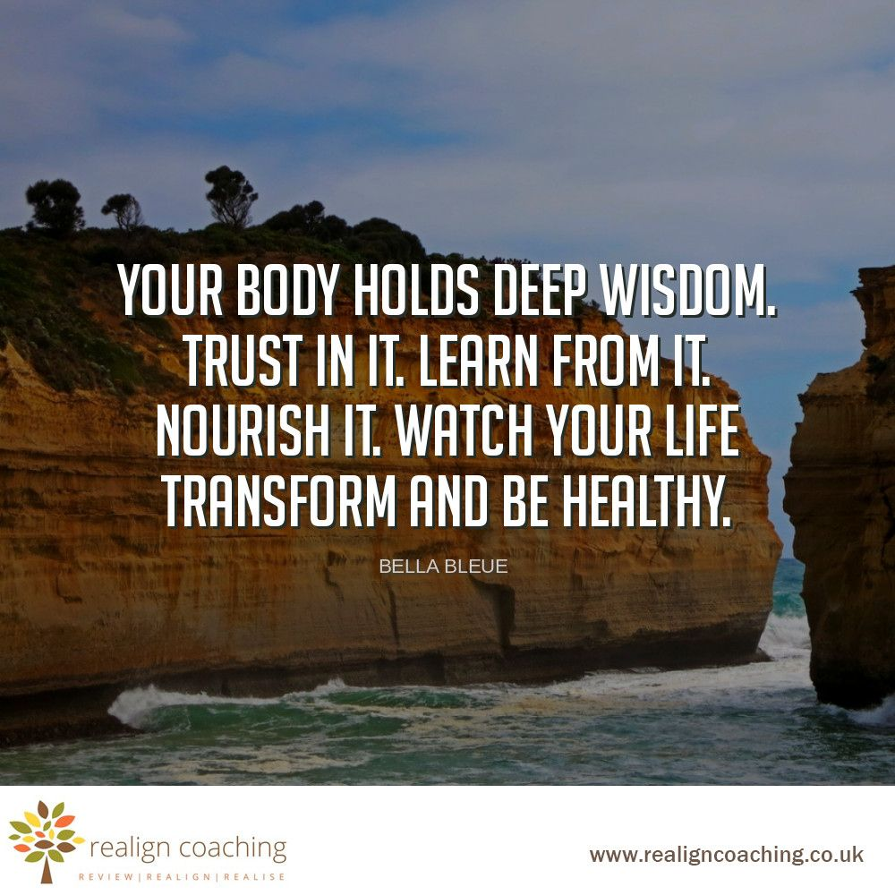
Wisdom
Wisdom and Well-Being
Significantly correlated with
life satisfaction
sense of mastery
purpose in life and
greater physical well-being for both men and women
Notes:
Scholars on wisdom and well-being: Studies by Ardelt (1997, 2016) revealed that wisdom was significantly correlated with life satisfaction, sense of mastery, purpose in life, and greater physical well-being for both men and women. Greater wisdom, in particular the reflective wisdom dimension, helped to buffer the experience of adverse life events during the previous year (Ardelt & Jeste, 2016). The association between wisdom and physical health was investigated by Grossmann, Sahdra, and Ciarrochi (2016). They found that wise reasoning styles or wisdom-related reasoning was correlated with healthier heart rate variability (i.e., cardiac vagal tone), which is an indicator of stress. Wisdom also seems related to well-being through association with increased striving for the good life and greater preferences for personal growth and self-actualization (Scheibe, Kunzmann, & Baltes, 2009) as well as associations with autonomy, psychological-mindedness, purpose in life, and basic personality traits such as openness to experience, agreeableness, and conscientiousness (Wink & Staudinger, 2016).

Slide 16
Wisdom
Wisdom and Well-Being
Wise people show emotional and motivational preferences that enhance well-being
e.g., being inspired by a situation to come up with novel solution to a problem, rather than have anxiety and panic
Wise persons prefer cooperative conflict-management styles, rather than “I win, you lose”
Notes:
Scholars on wisdom and well-being: Studies by Ardelt (1997, 2016) revealed that wisdom was significantly correlated with life satisfaction, sense of mastery, purpose in life, and greater physical well-being for both men and women. Greater wisdom, in particular the reflective wisdom dimension, helped to buffer the experience of adverse life events during the previous year (Ardelt & Jeste, 2016). The association between wisdom and physical health was investigated by Grossmann, Sahdra, and Ciarrochi (2016). They found that wise reasoning styles or wisdom-related reasoning was correlated with healthier heart rate variability (i.e., cardiac vagal tone), which is an indicator of stress. Wisdom also seems related to well-being through association with increased striving for the good life and greater preferences for personal growth and self-actualization (Scheibe, Kunzmann, & Baltes, 2009) as well as associations with autonomy, psychological-mindedness, purpose in life, and basic personality traits such as openness to experience, agreeableness, and conscientiousness (Wink & Staudinger, 2016).

Slide 17
Wisdom: Perspectives
Life Stage Approach
Postformal Cognitive Development
Wisdom as a specific type of excellence

Slide 18

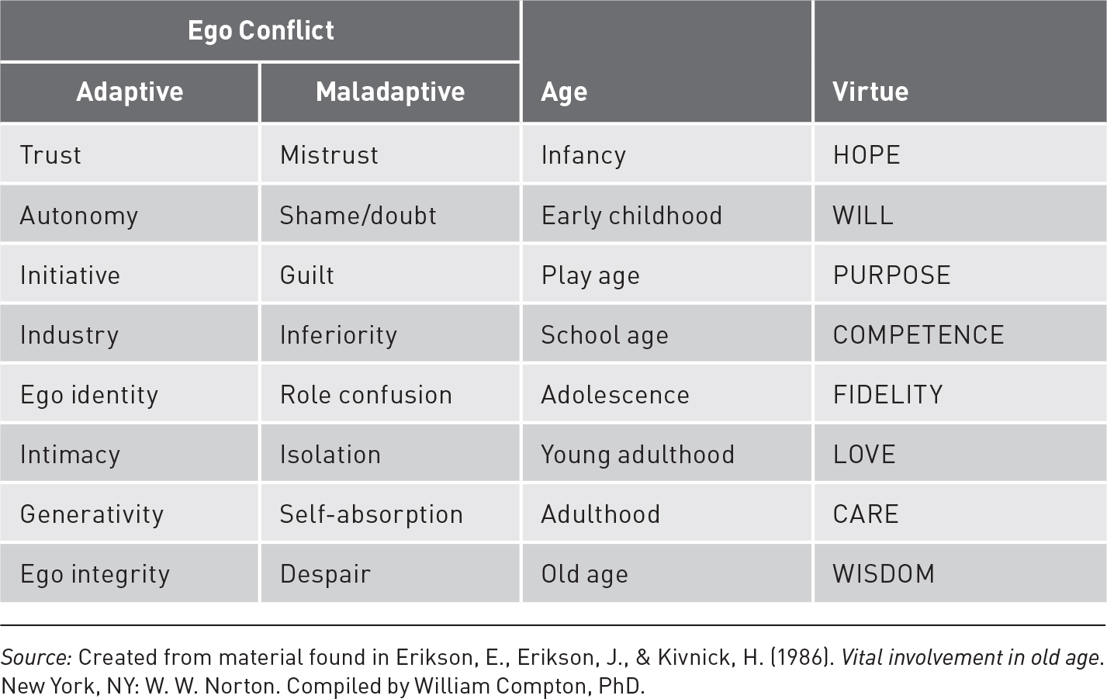
Wisdom
Wisdom as a Stage of Life
Erik Erikson’s perspective on wisdom
Notes:
Erik Erikson’s perspective on wisdom: He regarded wisdom as the virtue that results from a successful resolution of the last psychosocial stage of development: integrity versus despair.

Slide 19
Wisdom
Wisdom as Postformal Cognitive Development
Jean Piaget Theory of Cognitive Development
Formal-operational thinking (last stage)
Thinking is more practical, flexible, dialectical/logical
Wisdom as a stage of cognitive thought that goes beyond formal operational thinking…a more highly complex style of problem solving
Wisdom is partially driven by a fear of appearing foolish
Notes:
Formal-operational thinking: Involves the ability to use abstract concepts in solving problems.

Slide 20
Wisdom
Wisdom as a Form of Excellence
Define wisdom as a specific type of excellence in the performance of one’s life
Similar to confluence approach utilized in study of creativity (ie, multifaceted)
Joint product between individual and their environment
Complex, highly differentiated, and associated with diverse cultural meanings, which make it very challenging to empirical study

Slide 21
Wisdom
Wisdom as a Form of Excellence: The predictors of wisdom (Baltes and Staudinger)
4 predictors of wisdom
Intelligence (accounted for about 2% of variance in wisdom)
Personality dispositions (about 2%)
Cognitive styles (about 15%)
Creativity and thinking styles (those related to evaluating and comparing issues, and tolerating ambiguity)
Life experiences (about 15%)
Notes:
Baltes and Staudinger’s four general factors: (1) intelligence; (2) personality dispositions; (3) cognitive styles; and 4) life experiences.

Slide 22
Wisdom
Aristotle: Wisdom as the “Master” Virtue
Wisdom was the “master virtue” that allowed a person to discern which virtues were most important and how the various virtues should be balanced in life
Appropriate development of strengths in one’s virtues allowed for the cultivation of practical wisdom
Practical e.g., when is honesty the best policy; when is courage foolhardy or a virtue
Wise people pursue “good life” by eudaimonic strategies that seek meaning and purpose in life as primary goal, and positive emotionality as secondary
Notes:
Blaine Fowers’ five character types: Blaine Fowers (2005) posited five character types, each defined by how well the virtues are acknowledged and balanced. These move from those in which people ignore the basic human virtues (i.e., the “beastly” and “vicious” types) to those in which people know what they should do but struggle to act in ways that are consistent with those values (i.e., “incontinent” and “continent” types). The most mature character type is the virtuous. The virtuous character type is “able to act consistently in a way that is fitting, given the circumstances. Virtuous character is guided by a clear vision of what is good and admirable, and the individual acts consistently and gladly in the service of those goods” (Fowers, 2008, p. 645). In addition, the virtuous character is motivated by a love of what is good. There is no struggle to act well because one’s desires are harmonious with the higher virtues.

Slide 23
Wisdom
How to Cultivate Wisdom (Difficult to teach wisdom)
Practice dialectical and reflective thinking skills about difficult problems (practice thinking about all sides of a problem)
Read writings of important thinkers
Familiarize self with literature and art that deal with human situation
Read biographies of wise people
Empathy and compassion, necessary aspects of wisdom
Greater emotional regulation
Notes:
Difficult to teach wisdom:
Requires an ability to use post-formal thinking that works with contradictory, conflicting, or paradoxical ideas.
Requires openness to experiences along with “the ability to transcend one’s narrow perspective and self-interest” (Leary & Guadagno, 2011, p. 142).
Truly wise people act according to high ethical standards and seek the common good.

Slide 24
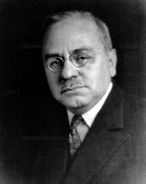
Early Psychodynamic Ideas on Optimal Personality
Alfred Adler
Innate striving for prosocial interactions and altruistic concern for others drives self-realization
Gemeinschaftsgefuhl
“social interest” a feeling of intimate relationship with humanity, empathy with human condition, sense of altruism
People are inherently social beings
Notes:
Gemeinschaftsgefuhl: Translated initially as "social sense," and then later as "social feeling" or social interest. Social feeling is an ideal or a goal that offered possibilities for behavior.

Slide 25
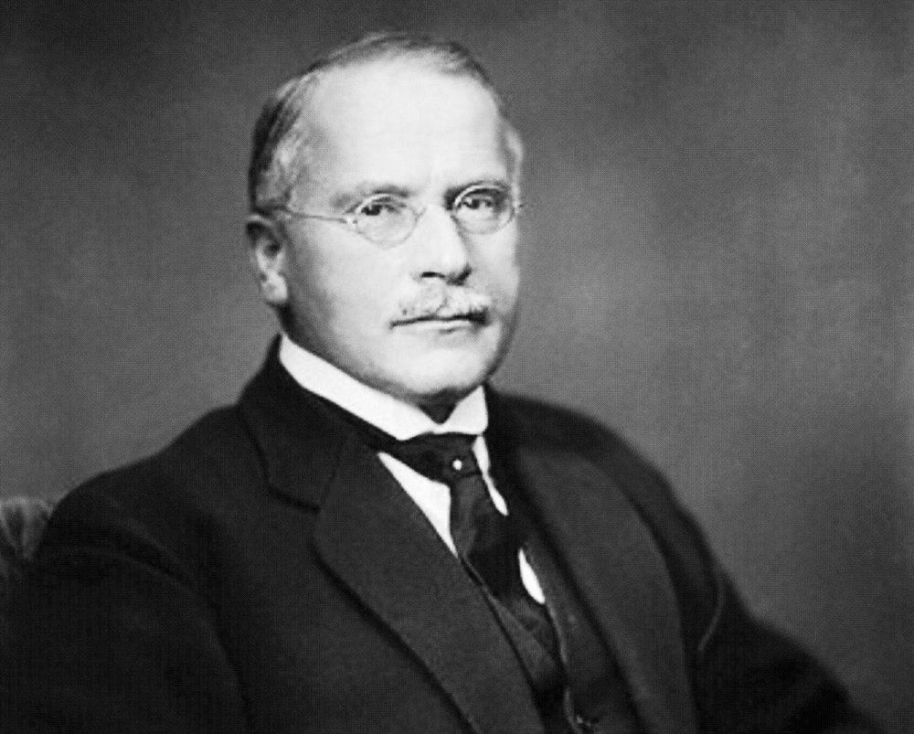
Early Psychodynamic Ideas on Optimal Personality
Carl G. Jung
An innate potential for optimal mental health that needs to be actualized
Collective unconscious deeper than the personal unconscious
Archetypes, contents of the collective unconscious
Notes:
Archetypes: The process of individuation, or self-realization, leads to the development and refinement of what Jung called the self archetype.

Slide 26
Early Psychodynamic Ideas on Optimal Personality
Carl G. Jung
Collective unconscious Archetypes
The process of individuation, or self-realization, leads to the development and refinement of what Jung called the self archetype
Optimal mental health should transcend one’s persona (occupation or social role)
Notes:
Archetypes: The process of individuation, or self-realization, leads to the development and refinement of what Jung called the self archetype.

Slide 27
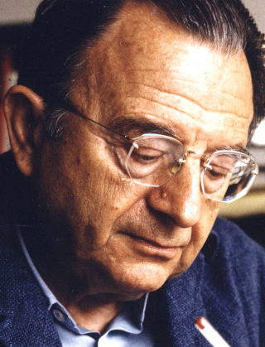
Early Psychodynamic Ideas on Optimal Personality
Erich Fromm
Our sense of being a fundamentally separate self creates a mind-set of both freedom and isolation…creates conflicts and anxiety (desire social connections but fear rejection; desire freedom but fear isolation)
Healthy way to deal with fundamental conflicts and fears is to accept them as part of life
Unhealthy methods of dealing with anxiety…Escape mechanisms
Notes:
Escape mechanisms: These are attempts to avoid real issues--or hide from the necessary struggle of facing one’s fears openly and honestly.

Slide 28
Early Psychodynamic Ideas on Optimal Personality
Erich Fromm: The Productive Orientation
Ideal of optimal mental health is an orientation toward being (expression of self using openness to and awareness of experience) rather than having (hides isolation behind possessions, rigid beliefs, and diversions designed to protect people from the truth)
Production of a real self

Slide 29
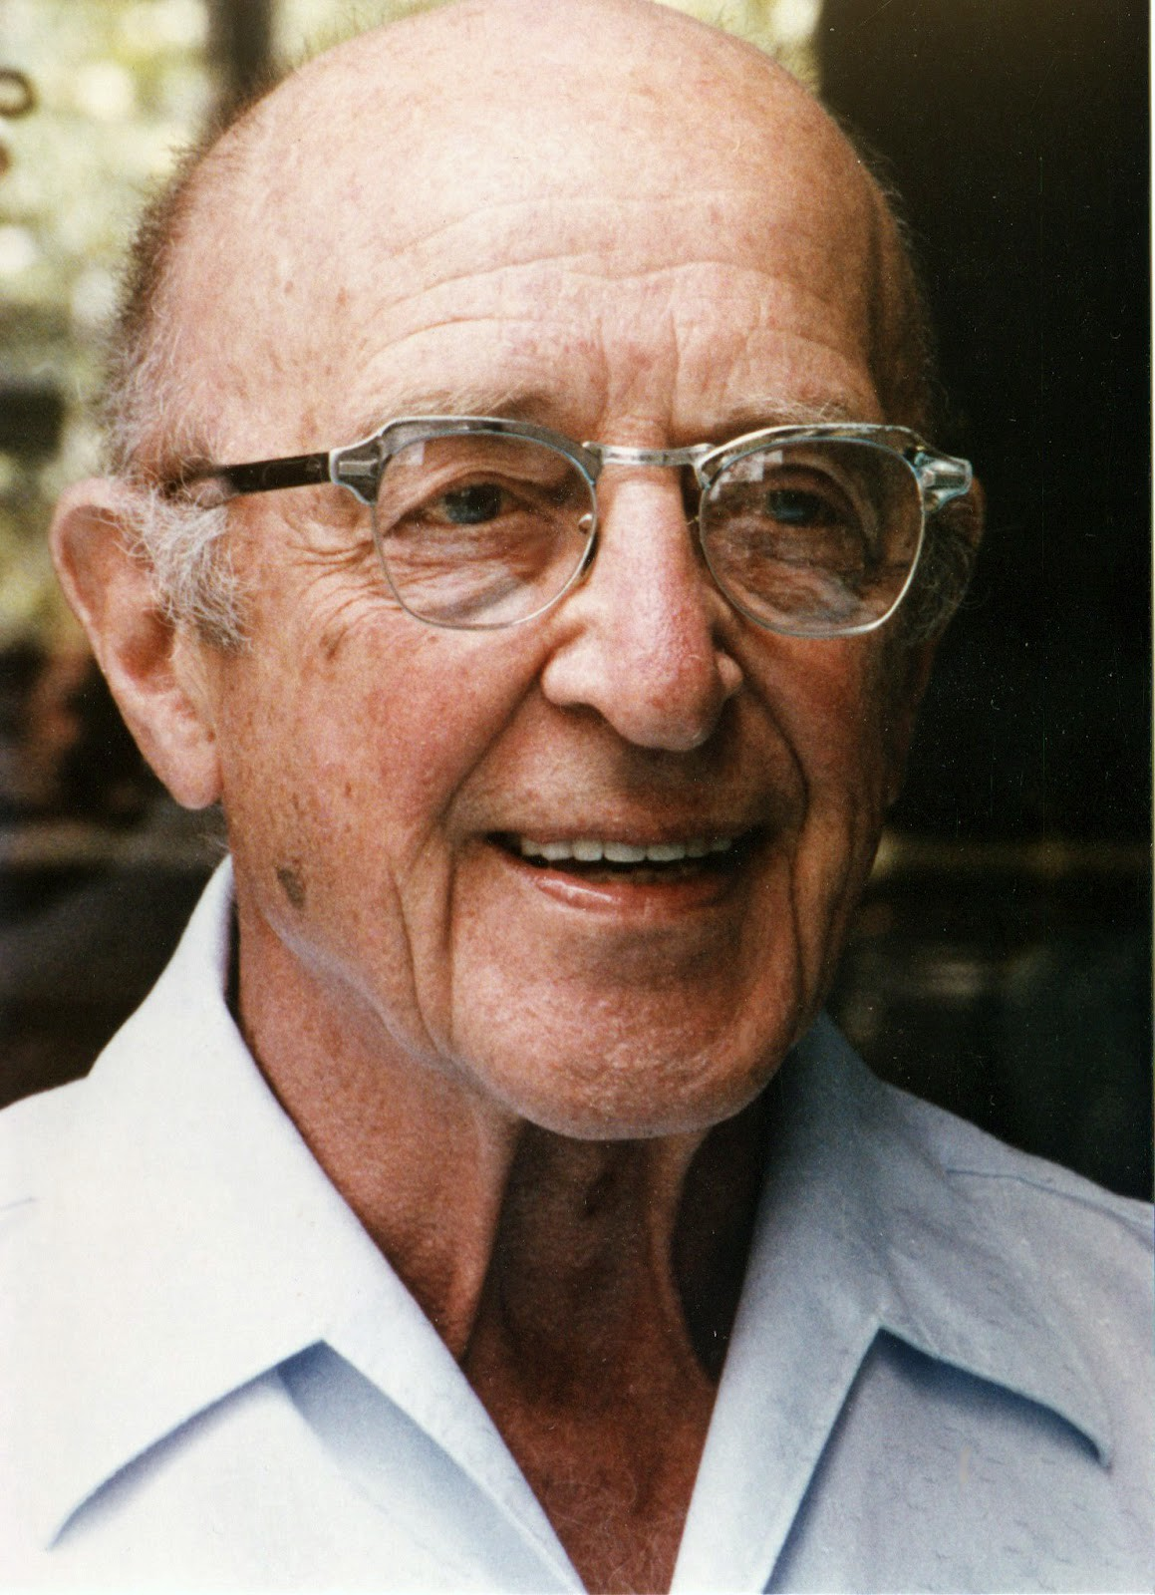
Humanistic Perspectives
Carl Rogers and the Fully Functioning Person
Self-actualizing tendency: An innate need to develop our potentials
Given the right circumstances, people find ways to fulfill potentials that will be both socially responsible and personally fulfilling
Problems come when we deny our own experiences of self in order to gain conditional acceptance from other people

Slide 30
Humanistic Perspectives
Carl Rogers: The fully functioning person
Psychological adjustment exists when relevant experiences of person are integrated into a coherent and flexible self-concept
Three major and two auxiliary criteria to characterize the fully functioning person
openness to experiences
Aware of internal and external stimuli; don’t use defense mechanisms
existential living (being present or mindful)
trust in one's own organismic experiences (intuition, instincts)
These three result in (4) a sense of freedom and (5) enhanced creativity
Notes:
Three major and two auxiliary criteria to characterize the fully functioning person: The fully functioning person exhibits: (1) openness to experiences, (2) existential living, and (3) trust in one's own organismic experiences. These three result in: (4) a sense of freedom and (5) enhanced creativity.

Slide 31
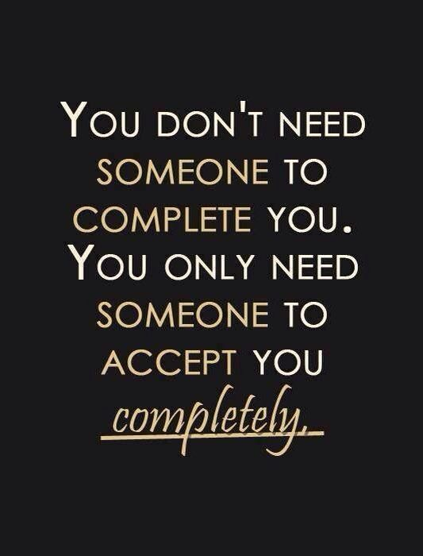
Humanistic Perspectives
Carl Rogers and the Fully Functioning Person
Rogers argued that when people exist in environments defined by unconditional love, empathic understanding, and genuineness, they grow psychologically toward their fullest potential

Slide 32
Humanistic Perspectives
Rogers: Living as a Fully Functioning Person
Movement is toward being what one actually is (not being more…with insecurity or defensiveness; not being less with guilt or self-deprecation)
Movement is toward self-direction, openness to experience, acceptance of others, and trust in self
Way of approaching and even welcoming life experiences
Notes:
Self-concordance and self-congruence: Self-concordance is found when there is high congruence between one’s personality and one’s goals (Sheldon & Kasser, 1998). In order to have higher congruence, it is necessary to become aware of one’s true self, what one really wants in life, and how to strive toward those goals.

Slide 33
Humanistic Perspectives
Rogers: Living as a Fully Functioning Person
Research on self-concordance based on Rogers’s theory
Self-concordance is found when there is high congruence between one’s personality and one’s goals…In order to have higher congruence, it is necessary to become aware of one’s true self, what one really wants in life, and how to strive toward those goals
Notes:
Self-concordance and self-congruence: Self-concordance is found when there is high congruence between one’s personality and one’s goals (Sheldon & Kasser, 1998). In order to have higher congruence, it is necessary to become aware of one’s true self, what one really wants in life, and how to strive toward those goals.

Slide 34
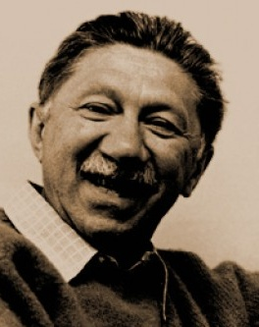
Humanistic Perspectives
Abraham Maslow and Self-Actualization: Early studies of self-actualizing people
Self-actualization, an ongoing process of development; process of fulfilling one’s potential
Exemplars were not the average person
Not possible in our society for young, developing people…needed experience and maturity
Argued about 1% of population reached self-actualization
Notes:
Not possible in our society for young, developing people: Maslow estimated that less than 1% of the adult population in the United States could be called highly self-actualizing.

Slide 35
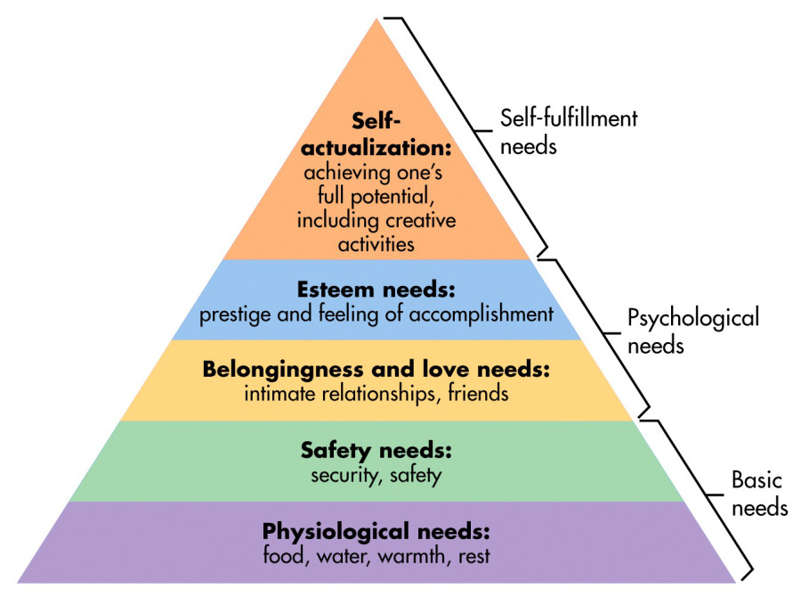
Humanistic Perspectives
Maslow’s Hierarchy of Inborn Needs
Theory proposed that personality developed based on basic human needs
Notes:
Five basic human needs:
Physiological and Safety. People must have their basic needs met for food, shelter, comfort, and freedom from disease.
Safety and security. People need to believe that they are relatively safe from physical harm and social disruptions and that they have some degree of control over their own destinies.
Love and belongingness. People need to feel connected to others and feel they are loved and cherished for who they are.
Self-Esteem. People need to feel a sense of competence and achievement and feel respected by other people in their lives.
Self-actualization. People have a need to develop their unique potential.
Preconditions necessary for satisfaction of the needs: Specific freedoms (i.e., freedom of speech, expression, inquiry) and necessary ethical principles (i.e., justice, fairness, honesty, orderliness).

Slide 36
Humanistic Perspectives
Abraham Maslow and Self-Actualization: Maslow’s Hierarchy of Inborn Needs
Preconditions necessary for satisfaction of the needs
Specific freedoms (e.g., speech)
Necessary ethical principles (justice, honesty)
Needs to know and to understand formed a second smaller needs hierarchy
Need for aesthetic expression for some as well
Notes:
Five basic human needs:
Physiological and Safety. People must have their basic needs met for food, shelter, comfort, and freedom from disease.
Safety and security. People need to believe that they are relatively safe from physical harm and social disruptions and that they have some degree of control over their own destinies.
Love and belongingness. People need to feel connected to others and feel they are loved and cherished for who they are.
Self-Esteem. People need to feel a sense of competence and achievement and feel respected by other people in their lives.
Self-actualization. People have a need to develop their unique potential.
Preconditions necessary for satisfaction of the needs: Specific freedoms (i.e., freedom of speech, expression, inquiry) and necessary ethical principles (i.e., justice, fairness, honesty, orderliness).

Slide 37
Humanistic Perspectives
Abraham Maslow and Self-Actualization: Motivation in Self-Actualizing People
Deficiency needs or D-needs (1-4)
Being needs or B-needs (SA)
B-needs more motivating than D-needs for self-actualizing people
B-needs: truth, justice, beauty, wholeness, richness, playfulness, meaningfulness, goodness

Slide 38
Humanistic Perspectives
Abraham Maslow and Self-Actualization: Motivation in Self-Actualizing People
Tension between security and growth
Max de Pree “The greatest thing is, at any moment, to be willing to give up who we are in order to become all that we can be”
Jonah complex
Idea that our deepest fear is that we are powerful beyond measures…Maslow suggests that as we let our light shine, we unconsciously give others permission to do the same

Slide 39
Humanistic Perspectives
Maslow Personality Traits of Self-Actualizing People
15 traits, self-actualizers don’t show all 15
Self-actualizers not perfect, but were free of neurotic anxieties and conflicts
Five categories
Openness to experience
Autonomy
Resistance to Aculturation
Positive relationships with others
Strong ethical standards
Notes:
Four categories:
1. Openness to experience--
More efficient perception of reality and more comfortable relations with it.
Acceptance (self, others, nature).
Continued freshness of appreciation.
Spontaneity.
Creativeness.
The mystical experience; the oceanic feeling.
2. Autonomy--
Autonomy, independence of culture and environment.
The quality of detachment; the need for privacy.
Resistance to enculturation.
3. Positive relationships with others--
Gemeinschaftsgefuhl (social interest).
Interpersonal relations.
Philosophical, unhostile sense of humor.
Problem-centering.
4. Strong ethical standards--
The democratic character structure.
Discrimination between means and ends.

Slide 40
Humanistic Perspectives
Maslow Personality Traits of Self-Actualizing People
Openness to experience
More efficient perception of reality and more comfortable relations with it
Acceptance (self, others, nature)
Continued freshness of appreciation
Spontaneity
Creativeness
The mystical experience: the oceanic feeling (peak experiences)
Notes:
Four categories:
1. Openness to experience--
More efficient perception of reality and more comfortable relations with it.
Acceptance (self, others, nature).
Continued freshness of appreciation.
Spontaneity.
Creativeness.
The mystical experience; the oceanic feeling.
2. Autonomy--
Autonomy, independence of culture and environment.
The quality of detachment; the need for privacy.
Resistance to enculturation.
3. Positive relationships with others--
Gemeinschaftsgefuhl (social interest).
Interpersonal relations.
Philosophical, unhostile sense of humor.
Problem-centering.
4. Strong ethical standards--
The democratic character structure.
Discrimination between means and ends.

Slide 41
Humanistic Perspectives
Maslow Personality Traits of Self-Actualizing People
Autonomy
Autonomy, independence of culture and environment (self-esteem not based on how others thought of them)
Quality of detachment, the need for privacy
Notes:
Four categories:
1. Openness to experience--
More efficient perception of reality and more comfortable relations with it.
Acceptance (self, others, nature).
Continued freshness of appreciation.
Spontaneity.
Creativeness.
The mystical experience; the oceanic feeling.
2. Autonomy--
Autonomy, independence of culture and environment.
The quality of detachment; the need for privacy.
Resistance to enculturation.
3. Positive relationships with others--
Gemeinschaftsgefuhl (social interest).
Interpersonal relations.
Philosophical, unhostile sense of humor.
Problem-centering.
4. Strong ethical standards--
The democratic character structure.
Discrimination between means and ends.

Slide 42
Humanistic Perspectives
Maslow Personality Traits of Self-Actualizing People
Resistance to Enculturation
Able to examine culture more objectively and see the contradictions, inconsistencies, and errors that existed
Notes:
Four categories:
1. Openness to experience--
More efficient perception of reality and more comfortable relations with it.
Acceptance (self, others, nature).
Continued freshness of appreciation.
Spontaneity.
Creativeness.
The mystical experience; the oceanic feeling.
2. Autonomy--
Autonomy, independence of culture and environment.
The quality of detachment; the need for privacy.
Resistance to enculturation.
3. Positive relationships with others--
Gemeinschaftsgefuhl (social interest).
Interpersonal relations.
Philosophical, unhostile sense of humor.
Problem-centering.
4. Strong ethical standards--
The democratic character structure.
Discrimination between means and ends.

Slide 43
Humanistic Perspectives
Maslow Personality Traits of Self-Actualizing People
Positive relationships with others
Social interest…empathy, compassion
Interpersonal relations more intense, profound
Philosophical, unhostile sense of humor
Problem-centering
Notes:
Four categories:
1. Openness to experience--
More efficient perception of reality and more comfortable relations with it.
Acceptance (self, others, nature).
Continued freshness of appreciation.
Spontaneity.
Creativeness.
The mystical experience; the oceanic feeling.
2. Autonomy--
Autonomy, independence of culture and environment.
The quality of detachment; the need for privacy.
Resistance to enculturation.
3. Positive relationships with others--
Gemeinschaftsgefuhl (social interest).
Interpersonal relations.
Philosophical, unhostile sense of humor.
Problem-centering.
4. Strong ethical standards--
The democratic character structure.
Discrimination between means and ends.

Slide 44
Humanistic Perspectives
Maslow Personality Traits of Self-Actualizing People
Strong Ethical Standards
Democratic character structure
Rank, class, status, education attainment…listen to all who might have something worthwhile to say
Discrimination between means and ends
Strong sense of ethics and morality is what Maslow intended this to mean
Clearly differentiated right from wrong and lived according to those values
Notes:
Four categories:
1. Openness to experience--
More efficient perception of reality and more comfortable relations with it.
Acceptance (self, others, nature).
Continued freshness of appreciation.
Spontaneity.
Creativeness.
The mystical experience; the oceanic feeling.
2. Autonomy--
Autonomy, independence of culture and environment.
The quality of detachment; the need for privacy.
Resistance to enculturation.
3. Positive relationships with others--
Gemeinschaftsgefuhl (social interest).
Interpersonal relations.
Philosophical, unhostile sense of humor.
Problem-centering.
4. Strong ethical standards--
The democratic character structure.
Discrimination between means and ends.

Slide 45
Humanistic Perspectives
Abraham Maslow and Self-Actualization: Research on Self-Actualization
Complicated to review, some support, some not
Little empirical evidence for ascendancy of needs
More support for self-actualization as metric for well-being
Higher scores on measures of self-actualization reflect greater well-being
Notes:
Five dimensions of Maslow’s social world: 1) close friendships; 2) romantic love; 3) a satisfying marriage; 4) devoted and effective parenthood; and 5) serving others through vocation or volunteer activity.

Slide 46
Humanistic Perspectives
Abraham Maslow and Self-Actualization: How to Be More Self-Actualizing
Recommendations follow the 15 personality traits
Determine what motivates you and try taking more growth-producing risks (not thrill-seeking risks as those are satisfying D-needs)

Slide 47
Purpose in Life, the Quiet Ego, and Personal Growth
Purpose in Life
Well-being may be best understood by looking at purpose in life (Kashdan & McKnight)
Purpose in life different from sense of meaning…having a sense of purpose catalyzes our sense of meaning
Three pathways to creating a sense of purpose
Through proactive effort in goal pursuits
By a transformative life event that give clarity to a person’s life
With social learning by observation of other people
Research: engagement with any pathway led to greater well-being

Slide 48
Purpose in Life, the Quiet Ego, and Personal Growth
Jack Bauer and the Quiet Ego
Quiet ego
A concept of maturity
A self-identity that transcends egoism and identifies with a less defensive, balanced stance toward the self and others
https://www.researchgate.net/publication/263698405_The_Quiet_Ego_Scale_Measuring_the_Compassionate_Self-Identity
Image: self-assured, humble, wise
Louder/noisier ego
Interprets world as more individualistic, immediate, concrete, and defined more by the external world
Image: brash, self-focused, more concerned with own welfare

Slide 49
Purpose in Life, the Quiet Ego, and Personal Growth
Personal Growth Initiative
An active, intentional engagement in the process of personal growth
People high on personal growth
More open to experiences
Seek improvement in themselves
Have strong sense of self-direction
Pursue enduring goals
People with high level of personal growth initiative know the direction they would like to grow, appear able to capitalize on opportunities for growth, seek opportunities for creativity and adaptive solutions
Notes:
People high on personal growth: People high on personal growth are open to experiences, seek improvement in themselves, have a strong sense of life direction and enduring goals.
People with high level of personal growth initiative: Know the directions in which they would like to grow, appear able to capitalize on opportunities for personal growth, and seek opportunities for creativity and adaptive solutions.

Slide 50
Purpose in Life, the Quiet Ego, and Personal Growth
Personal Growth and Human Potential
Personal growth therapy or human potential
Normal psychological and social adjustment don’t represent a goal
Techniques of therapy or workshops
Designed to tap creative potential
Build self-confidence
Increase motivation for success
Communicate better with others
Human potential interventions not adequately assessed for effectiveness

Slide 51
The Optimal Personality: Common Themes
Marie Jahoda and Ideal Mental Health
Six criteria and associated subcategories
Attitudes toward self (self-acceptance, -confidence, -reliance)
Growth, development and self-actualization
An integrated personality
Autonomy
Perception of reality (no distortions, greater social sensitivity)
Environmental mastery (successful adaptation to situational demands and expectations)
Ryff’s theory of Psychological Well-Being based on Jahoda’s work
Notes:
Six criteria and associated subcategories:
Attitudes toward the self--there were four main subcategories: (a) adequate self-awareness, (b) accurate self-concept, (c) self-acceptance, and (d) a positive and “globally benevolent” view of the self.
Growth, development, and self-actualization.
An integrated personality.
Autonomy.
Perception of reality.
Environmental mastery

Slide 52
The Optimal Personality: Common Themes
Personality Traits Important for Optimal Well-Being
Openness to experience
Curiosity
Exploration
Absorption
Courage
Four dimensions of courage
Notes:
Four dimensions of courage: 1) willfulness and intentionality; (2) mindful deliberation; (3) objective substantial risk; and (4) a noble or worthy end (Rate, Clarke, Lindsay, & Sternberg, 2007).

Slide 53
The Optimal Personality: Common Themes
Personality Traits Important for Optimal Well-Being
Four dimensions of courage
willfulness and intentionality
mindful deliberation
objective substantial risk
a noble or worthy end
Notes:
Four dimensions of courage: 1) willfulness and intentionality; (2) mindful deliberation; (3) objective substantial risk; and (4) a noble or worthy end (Rate, Clarke, Lindsay, & Sternberg, 2007).

Slide 54
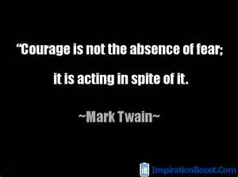
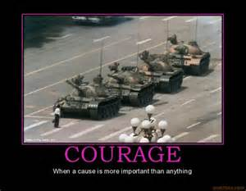
Theories of Courage
Courage appreciated in many cultures
At least18 different
conceptualizations of courage

Slide 55
Implicit Theories of Courage
O’Byrne, Lopez, & Peterson (2000)
- Courage perceived as:
an attitude
a behavior
mental strength
physical strength
risk-taking
role of fear

Slide 56
Implicit Theories of Courage
Values In Action system (Peterson and Seligman)
Courage (core human virtue) comprising the following strengths:
Valor
Taking physical, intellectual, and emotional stances in the face of danger
Authenticity This Is Me song
Representing self to others and self in sincere fashion
Enthusiasm/zest
Thriving/having sense of vitality in challenging situation
Industry/perseverance
Undertaking challenges and tasks and finishing them

Slide 57
Implicit Theories of Courage
Physical Courage
Maintain societal goals by using physical behavior in the pursuit of socially valued goals
Moral Courage
Behavioral expression of authenticity in the face of the discomfort of dissention, disapproval, or rejection
Vital Courage
Perseverance through disease or disability even when outcome is ambiguous

Slide 58
Implicit Theories of Courage

Slide 59
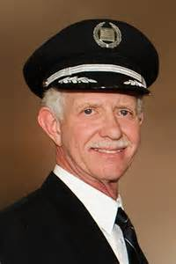
Physical Courage
Capt. Sullenberger and the “Miracle
on the Hudson” (2009)
Interview 5 years later

Slide 60
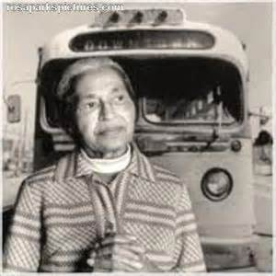
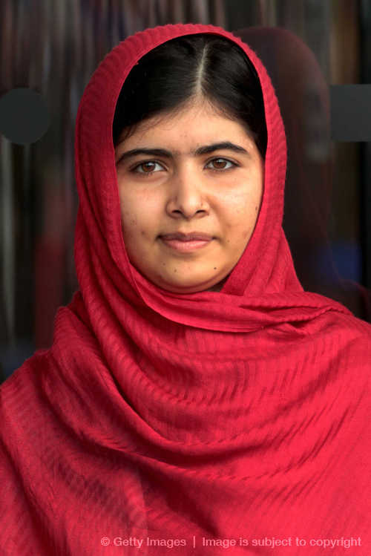
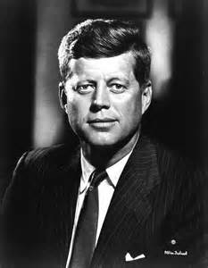
Moral Courage
Malala Yousafzai

Slide 61
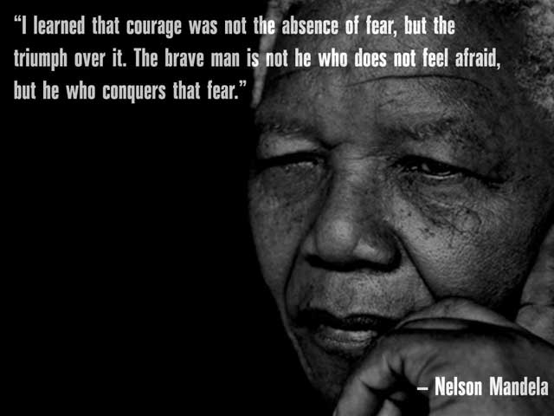
Moral Courage
Moral courage is “Standing up for values…the willingness to take a tough stand for right in the face of danger…the courage to do the right thing…the quality of mind and spirit than enables one to face up to ethical challenges firmly and confidently without flinching or retreating” (Kidder, 2006, p.72)
Kidder directs the Institute of Global Ethics

Slide 62
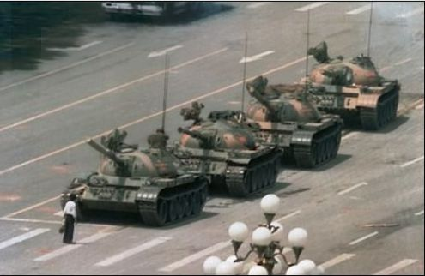
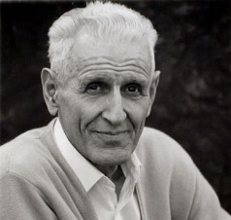
Kidder Moral Courage: 3 Components
Commit to core set of moral values and principles
Recognize we are likely to experience and face danger by standing up for these principles
Physical threat, loss, rejection, shame, or disappointment
Must be willing to endure that danger and continue to do what we know is right, even if it means loss, disapproval, or shame
Dr. Jack Kevorkian, publicly championed a terminal patient's right to die via physician-assisted suicide

Slide 63
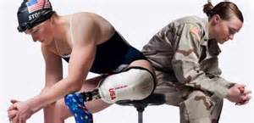
Vital Courage
Physicians, nurses, and other health professionals
Chronically ill adolescents
Case study: Army veteran Melissa Stockwell

Slide 64
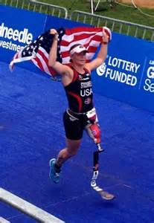
Melissa Stockwell
Melissa Stockwell
Interview
Her initial thoughts after waking up in the ER in Iraq after a roadside bomb took her leg was being thankful to have her life
When she got to Walter Reed Army Medical Center she thought she was one of the lucky ones

Slide 65
Implicit Theories of Courage
Putman (1997)
- Psychological courage:
strength in facing one’s destructive habits
a form of vital courage
Paucity of training for psychological courage

Slide 66
Empowering Women…sorry, not sorry
Pantene Sorry, Not Sorry Commercial

Slide 67
Implicit Theories of Courage
Greitemeyer and colleagues (2007)
- Civil Courage:
Brave behavior accompanied by anger and indignation that intends to enforce societal and ethical norms
Separate from altruism in that bodily harm is risked

Slide 68
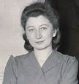
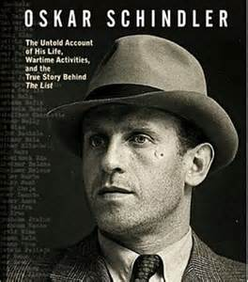
Courageous Altruism
Studied non-Jewish “rescuers” and “bystanders”
Differed in terms of:
Social responsibility Empathic concern
Risk taking
Altruistic moral reasoning
Miep Gies (hid Anne Frank)

Slide 69
Undoing Fear Conditioning
When life knocks you down, get back up…as quickly as you can!
Memories are unstable/malleable for a short period of time, where if we add another experience it may create a new memory…alter consolidation of memory
New experience may not have to be so quick…Recent research suggests that each time a memory is retrieved, it is once again unstable for a brief period until it is reconsolidated
Erasing Fear Memories

Slide 70

Practical Applications: Learning to Face Fear
View fear as a guide
View fear as normal, not something to avoid
Accept it, welcome it
There is a difference between fear and panic
Navy SEALS Mental Training
Moderate levels of fear may sharpen focus and decision making
View fear as an opportunity
To develop courage, self-esteem, a sense of mastery
Focus on the goal or mission
Looking ahead for a bigger view of the situation
Sullenberger Miracle on the Hudson
“challenge of a lifetime” and also provided “opportunities”

Slide 71
Practical Applications: Learning to Face Fear
Acquire information about what is feared
Helps to build self-efficacy
Practice, practice, practice so not as overwhelmed or surprised by the unknown

Slide 72

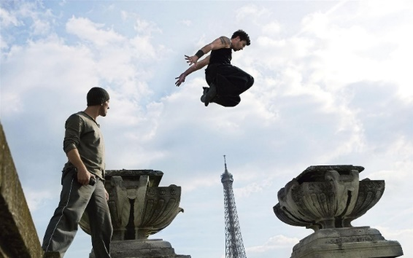
Practical Applications: Learning to Face Fear
Learn and practice the skills necessary to master the fear
Helps to build self-efficacy…mastery experience
Navy SEALS How to get over a wall
David Belle and Parkour An Interview
Face fear with friends and colleagues
Face fear with spiritual support
Get someone or an organization to push you

Slide 73
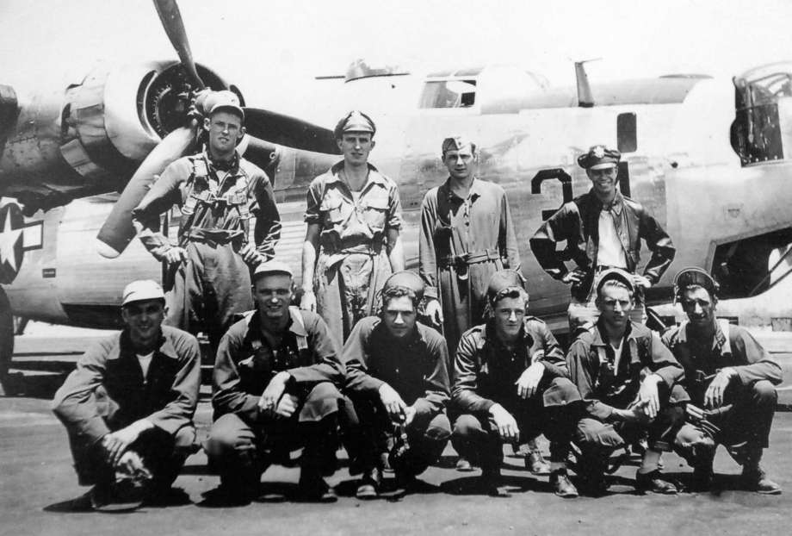
Practical Applications: Learning to Face Fear
Face fear with friends
and colleagues
Face fear with spiritual support
Milton Klarsfeld, Albany businessman, WWII POW, upon capture was placed in a box for 10 days where he nearly starved to death. It was during this time that he planned out the rest of his life. It gave him hope for the future.
Get someone or an organization to push you

